Slide 1

The Abandoned Housing Effect on Newark
Rutgers Data Analysis
By: Amita Abhang, Melat Bekele,
Ernesto Cancel, Isabella Lehar, and Tim Weir

Slide 2
Project Info
Quick Overview of Project Objectives

Slide 3
Abandoned Housing Effect Abstract:
There are multiple abandoned and vacant buildings within the city limits of Newark, NJ. Through this project, we will examine the overall city statistics of crime, education, and demographics and then find the total number of abandoned and vacation buildings. We want to see how the different zip codes within Newark vary by crime, education, and demographics and how many abandoned and vacant buildings each one has.

Slide 4
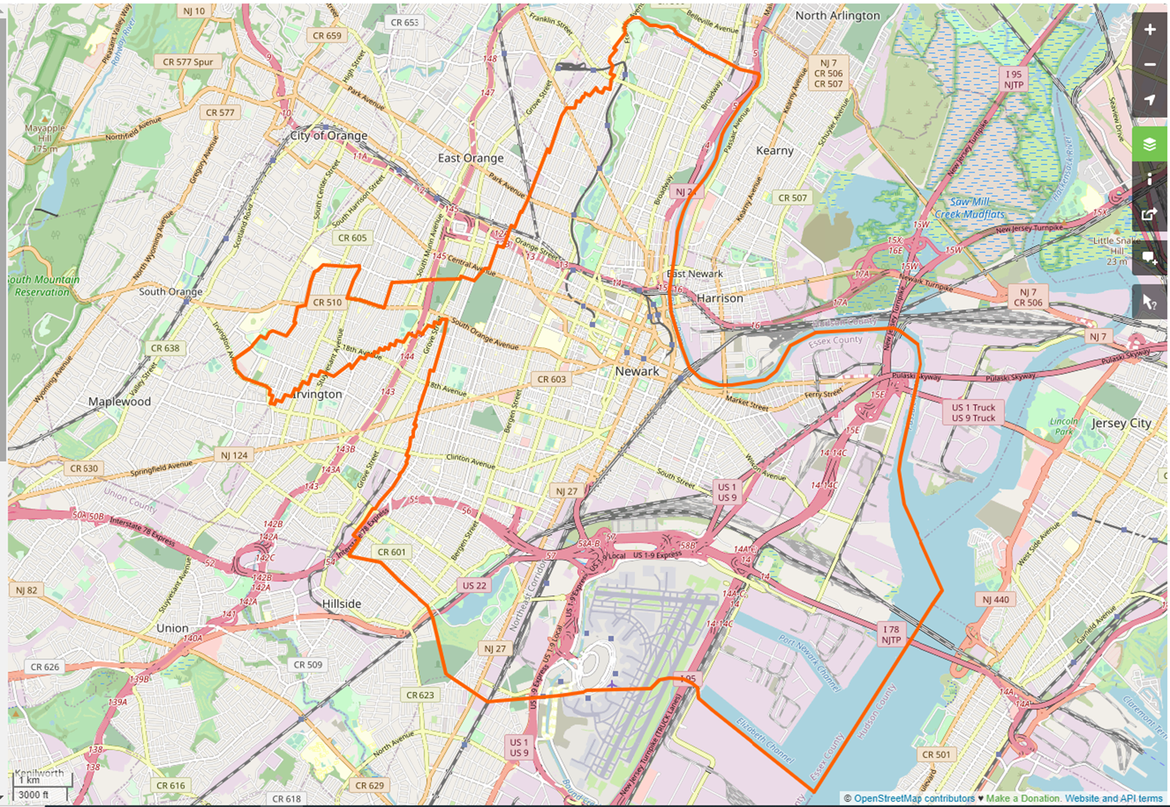
Map of Newark City Limits
Source: TIGER/Line® 2008 Place Shapefiles (http://www.census.gov/geo/www/tiger/)

Slide 5
Overall Housing

Slide 8
Abandoned Housing

Slide 9
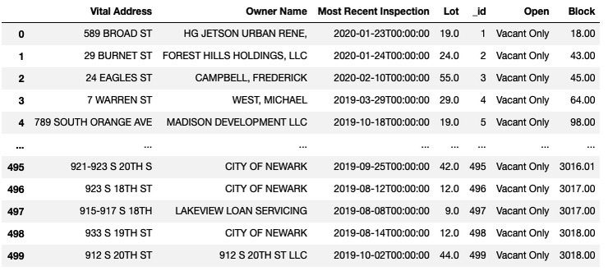
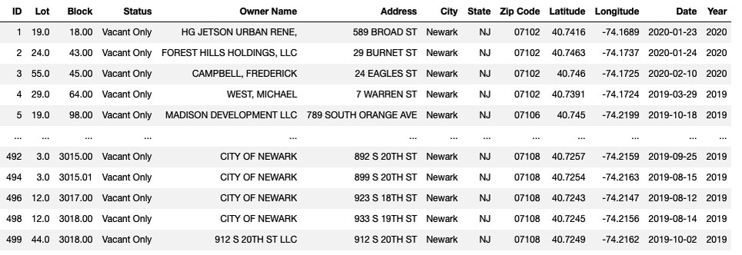
ABANDONED PROPERTY IN THE CITY OF NEWARK
The City of Newark maintains an abandoned property list which is callable via API containing approximately 500 abandoned properties.
The data is not compatible with data from other sources, addresses are incomplete and not suitable for data analysis.
Various data cleaning techniques were employed resulting in usable data that is now compatible with additional data sets for deeper analyses.
The cleaning process resulted in minimal data loss.

Slide 10
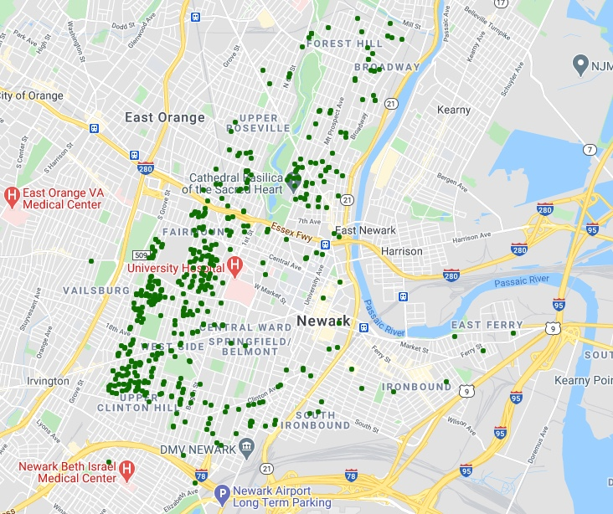
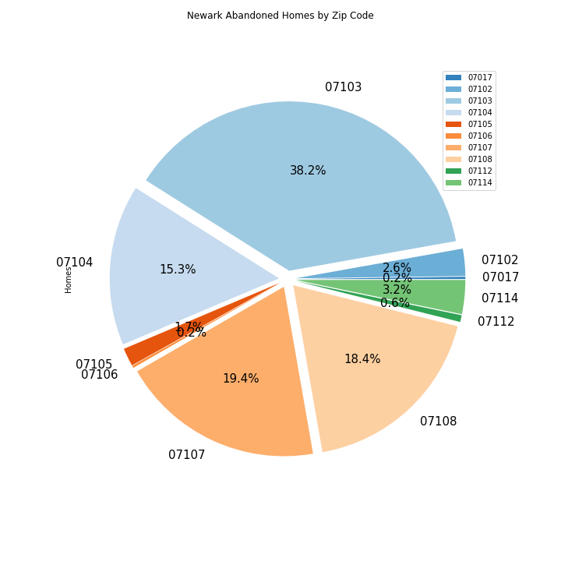

Slide 11
Poverty

Slide 12
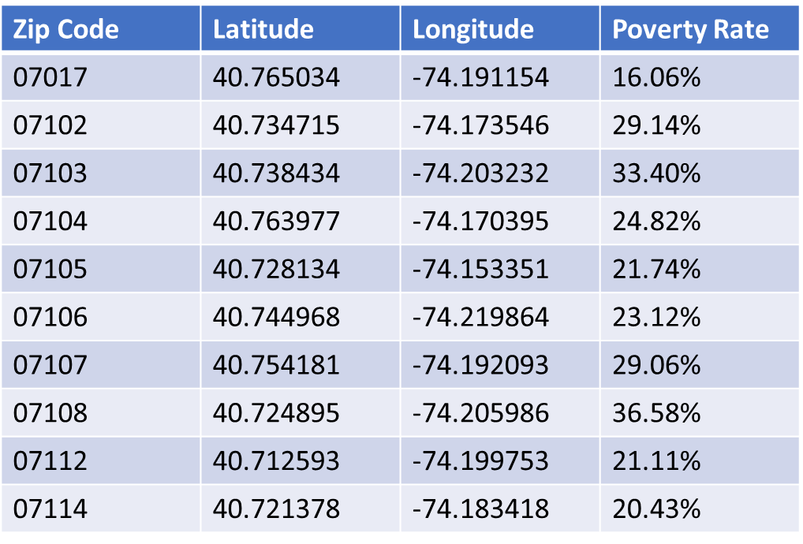
Poverty Rates in Newark, NJ by Zip Code
Data retrieved from 2019 US Census and Google Places API to show poverty rates within 10 Newark zip codes.
Geographic coordinates pulled from main abandoned property data frame.
Coordinates were averaged and then grouped by zip codes, an “alternative” to finding the geographic location of each zip code without using geocoder…
Here’s what the cleaned data frame looks like:

Slide 13
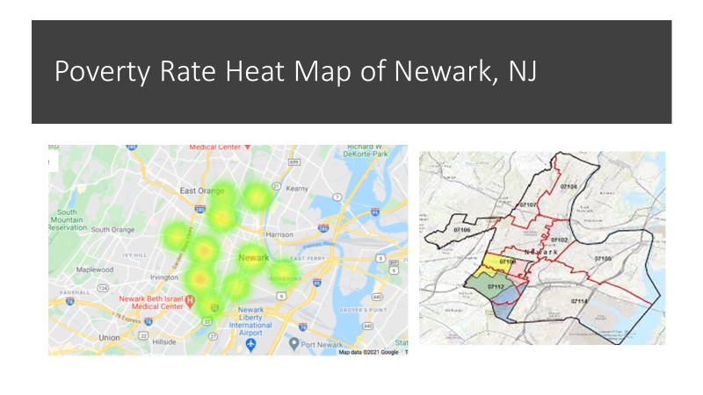

Slide 15
Education

Slide 18
Crime in Newark
Crimes rates 2018, 2019, 2020

Slide 19
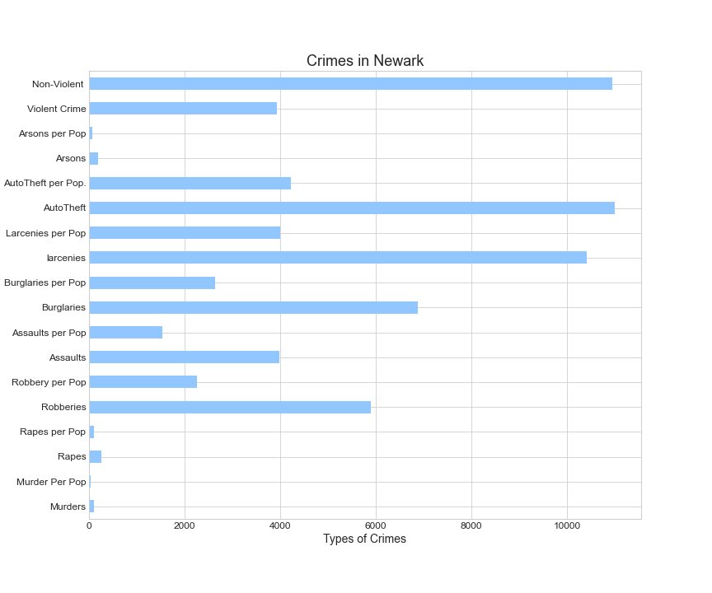
Crime within Newark
Crimes within Newark in 2018 by totals and by murders of the total population
Total population of 275221 at the time the study was taken.
Crimes | Totals
Murders | 96
Murder Per Pop | 36.89
Rapes | 257
Rapes per Pop | 98.76
Robberies | 5892
Robbery per Pop | 2264.13
Assaults | 3977
Assaults per Pop | 1528.25
Burglaries | 6879
Burglaries per Pop | 2643.41
larcenies | 10420
Larcenies per Pop | 4004.12
AutoTheft | 10993
AutoTheft per Pop. | 4224.31
Arsons | 184
Arsons per Pop | 70.71
Violent Crime | 3928.03
Non-Violent | 10942.54

Slide 20
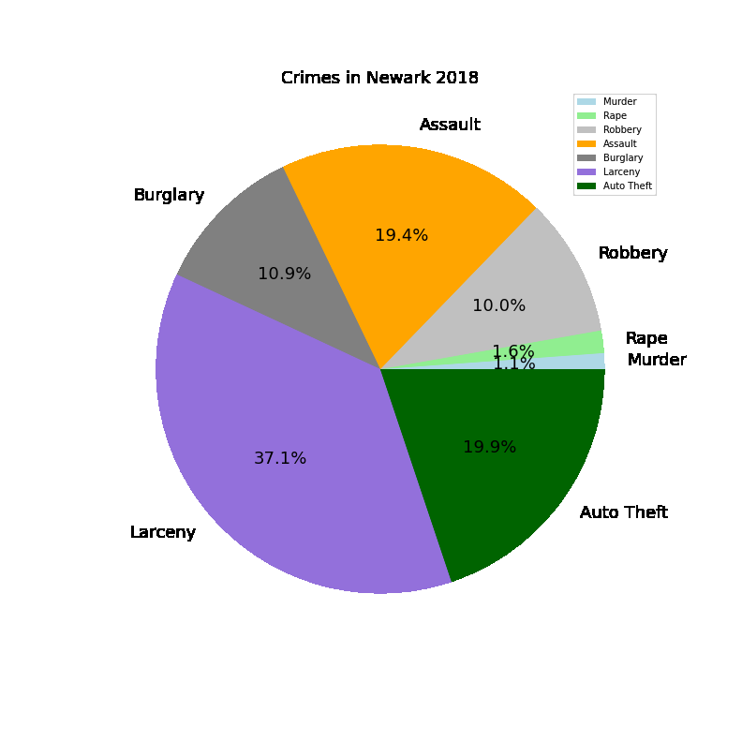
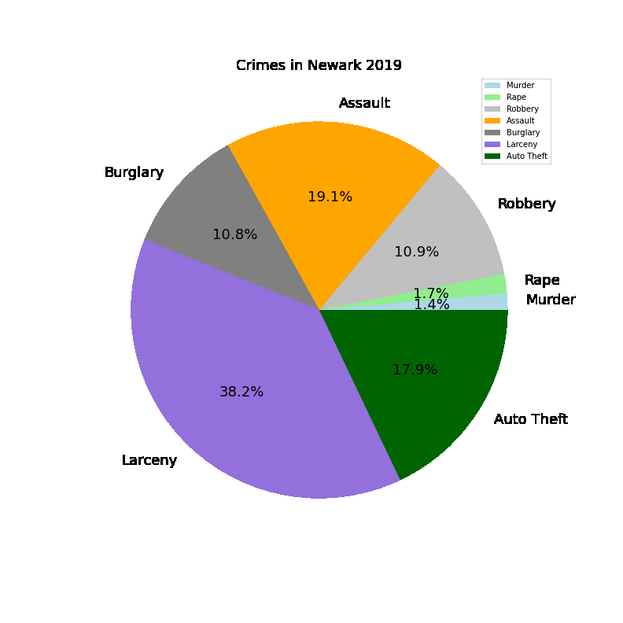
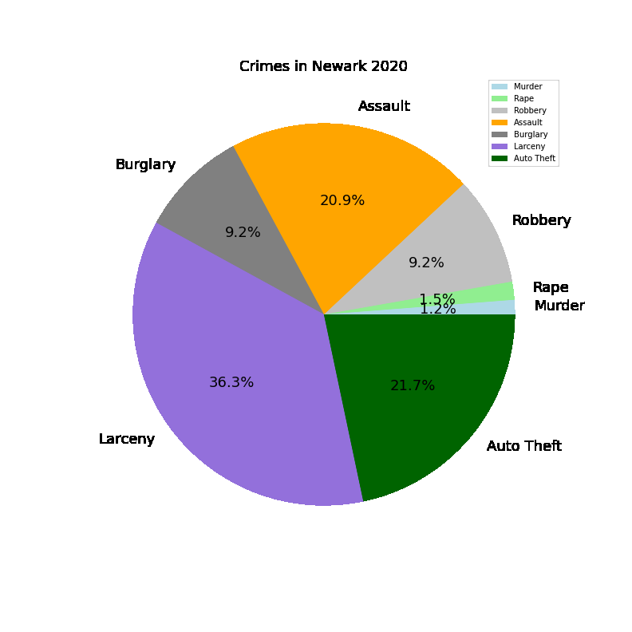
Crime Percentages 2018, 2019, 2020
 | Larceny | Burglary | Assault | Robbery | Rape | Murder | Auto Theft
2018 | 37.1% | 10.9% | 19.4% | 10.0% | 1.6% | 1.1% | 19.9%
2019 | 36.3% | 9.2% | 20.9% | 9.2% | 1.5% | 1.2% | 21.7%
2020 | 38.2% | 10.8% | 19.1% | 10.9% | 1.7% | 1.4% | 17.9%

Slide 21
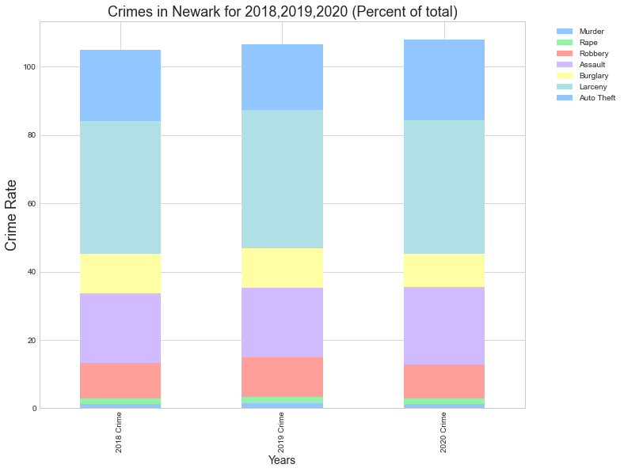
Total Crimes 2018, 2019, 2020

Slide 22
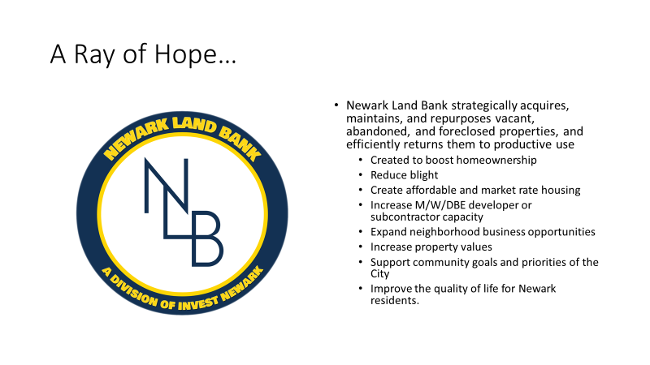

Slide 23
Citations
Newark abandoned housing data source
http://data.ci.newark.nj.us/dataset/abandoned-properties/resource/796e2a01-d459-4574-9a48-23805fe0c3e0
Poverty Data(slides )
2019 American Community Survey 5-Year . https://api.census.gov/data/2019/acs/acs5?get=NAME,group(B01001)&for=us:1
Newark Land Bank. (copyright 2021). https://landbank.investnewark.org/
City of Newark Open Data. http://data.ci.newark.nj.us/dataset/abandoned-properties
Crime Data(slides ):
New Jersey State Police, (copyright 2007-2021),Uniform Crime Reports, https://www.njsp.org/ucr/uniform-crime-reports.shtml
Communities and Crime Unnormalized Data Set. http://archive.ics.uci.edu/ml/machine-learning-databases/00211/

